Slide 1
Translating Mission to Market: Understanding Prospective Undergraduate Mindsets
Kim Reid, Principal Analyst
Eduventures Research

Slide 2
Agenda
Eduventures’ Prospective Student Mindsets
National CCAA Institutions and Mindsets
How to Work with Mindsets
Questions

Slide 3
About the Research
Eduventures 2018 Prospective Student Survey
National survey of college-bound high school juniors and seniors
NRCCUA’s MyOptions database
Institutional inquiry lists
Total sample: 54,267
Considering applying to CCAA school 9,286

Slide 4
Prospective Undergraduate Student Mindsets

Slide 5
A Developmental Arc

Slide 6
Great Institutions Serve Diverse Populations

Slide 7
How Student Mindsets Were Developed
Experiences
Outcomes
Criteria
Mindsets

Slide 8
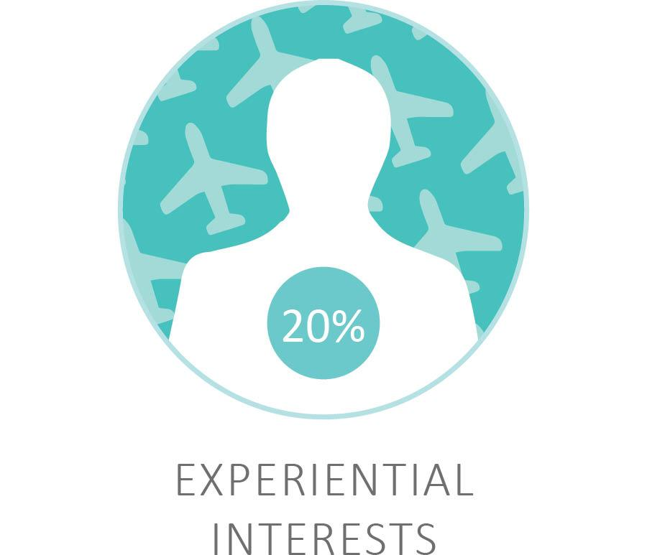
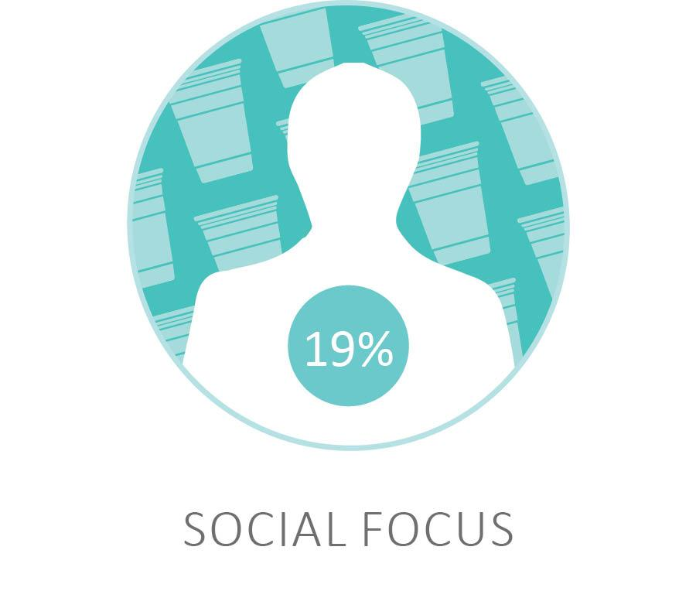
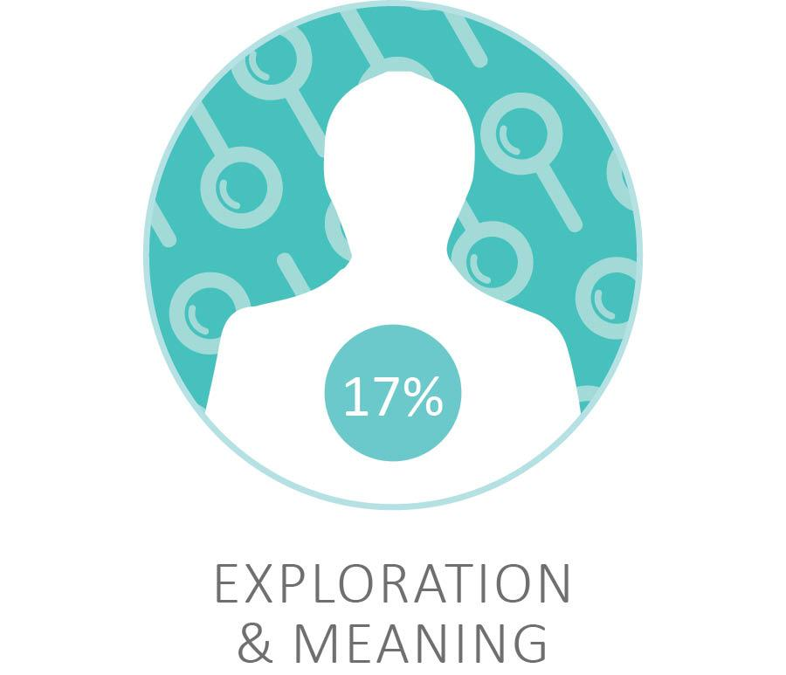
Gen Z Has Different Paths in Mind
Career
Experience
Academic
21%
21%
15%
19%
13%
11%

Slide 9
Mindsets are Linked to Enduring Personality Traits
 | Experiential Interests | Social Focus | Career Pragmatist | Exploration and Meaning | Career through Academics | Grad School Bound
Extraverted
Agreeable
Emotionally Stable
Conscientious
Open

Slide 10
Demography is not Destiny

Slide 11
As Demography Shifts, Career Orientation Likely to Increase
Student Mindsets by Access Status
Access Factors = First-generation college; low-income; underrepresented minority
Notes:
Access Factors:
First generation college
Low income
Underrepresented minority
Shall we color code these to the mindset above? I’m not convinced these are the most beautiful colors either (Dave?)

Slide 12
National Mindsets by Likely Institutional Destination

Slide 13
Shifting Priorities for Student Mindsets from Application to Enrollment

Slide 14
Top Two Priorities End Up the Same

Slide 15
National CCAA Institutions and Mindsets

Slide 16
Catholic Institutions Serve Different Missions
A Segmentation of CCCA Institutions
Based on NCES data
Admit rate
First-year retention
Six-year graduation
Percent Pell students
Percent underrepresented minorities
11 segments/neighborhoods identified
Focus on six segments for demonstration purposes
How do they these segments interact with student mindsets?

Slide 17
#1 Nearly Open Enrollment (17 Institutions)
Institutions that admit most applicants, struggle a bit with retention and quite a bit with graduation. But these institutions serve many Pell students and a fair amount of underrepresented minorities as well.

Slide 18
#2 Solid Performers (16 Institutions)
Well-known, but non-elite institutions, that do well on retention and graduation, but have modest numbers when it comes to serving Pell or underrepresented minorities.

Slide 19
#3 Feeling Pell Pressure (14 Institutions)
Modestly selective institutions with very low diversity that are feeling some Pell pressure.

Slide 20
#4 Urban Diverse (14 Institutions)
Solid performing institutions serving an average number of Pell students, but above average numbers of diverse students. All of these institutions are in urban settings.

Slide 21
#5 Highly Selective (10 Institutions)
These are the highly selective institutions with excellent retention and graduation rates. However, they are below par on serving underrepresented minorities and far below par on serving Pell students.

Slide 22
#6 Serving the Underserved (10 Institutions)
Institutions that serve very high numbers of Pell and underrepresented minorities students. Given the types of students these institutions serve, they have greater difficulty getting students to graduation.

Slide 23
National Mindsets by Institutional Destination (4 YR)

Slide 24
Unique Mindset Profiles within Categories
Urban Diverse Institutions – Application Interest Mindset Profile

Slide 25
Top Brand Perceptions of Solid Performers
Which of the following words do you associate with…

Slide 26
Perceptual Map by Mindset – Solid Performers
Notes:
Correspondence Analysis (Traditional) Inertia(s): Canonical Correlation Inertia Proportion Dimension 1 .134 .018 .438 Dimension 2 .102 .010 .256 Dimension 3 .082 .007 .162 Dimension 4 .061 .004 .090 Dimension 5 .047 .002 .054 Standard Coordinates: Which of the following words do you most associate with Dimension 1 Dimension 2 Dimension 3 Dimension 4 Dimension 5 High-quality -.02 -1.74 -.32 -.71 -.32 Religious 1.29 -.39 .92 .40 -1.13 Friendly/Inclusive 1.07 .00 -.20 -.76 -.38 Well-known -1.05 -.23 -1.36 .49 -.63 Intelligent/Intellectual -.20 -.72 -.54 -1.04 1.86 Fun/Exciting .97 1.44 -.92 1.68 -.13 Well-rounded/balanced .75 -.11 .76 .37 1.43 Career-minded -1.97 -.02 1.60 1.30 .15 Athletics -.96 .42 -1.90 -.01 .24 Comfortable 1.03 .68 -.55 -.16 .47 Community-oriented .49 -.33 -.47 -.50 .81 “Spirit” school .56 .38 -1.17 .88 -.28 Challenging -.78 1.72 .73 .57 1.59 Unique .70 1.35 1.13 -.92 -.20 Diverse -1.00 .87 1.04 -1.95 -1.09 Prestigious/Selective .49 .39 .54 -.82 -1.65 Value-for-the-money .17 -2.24 .88 2.86 -1.49 Hands-on -1.48 -1.03 -.49 1.02 .34 Traditional -.17 -.39 1.50 -.09 -.18 Familiar -1.98 -.95 .10 -1.20 -1.16 Dynamic/Energetic .26 -.58 2.41 .18 2.66 Affordable -.88 1.87 .50 -2.33 -1.35 None / don’t know -1.81 2.60 .30 -.01 -1.13 Principal Coordinates: Which of the following words do you most associate with Dimension 1 Dimension 2 Dimension 3 Dimension 4 Dimension 5 High-quality .00 -.18 -.03 -.04 -.02 Religious .17 -.04 .07 .02 -.05 Friendly/Inclusive .14 .00 -.02 -.05 -.02 Well-known -.14 -.02 -.11 .03 -.03 Intelligent/Intellectual -.03 -.07 -.04 -.06 .09 Fun/Exciting .13 .15 -.08 .10 -.01 Well-rounded/balanced .10 -.01 .06 .02 .07 Career-minded -.26 .00 .13 .08 .01 Athletics -.13 .04 -.16 .00 .01 Comfortable .14 .07 -.05 -.01 .02 Community-oriented .07 -.03 -.04 -.03 .04 “Spirit” school .07 .04 -.10 .05 -.01 Challenging -.10 .18 .06 .03 .08 Unique .09 .14 .09 -.06 -.01 Diverse -.13 .09 .08 -.12 -.05 Prestigious/Selective .07 .04 .04 -.05 -.08 Value-for-the-money .02 -.23 .07 .17 -.07 Hands-on -.20 -.11 -.04 .06 .02 Traditional -.02 -.04 .12 -.01 -.01 Familiar -.27 -.10 .01 -.07 -.05 Dynamic/Energetic .03 -.06 .20 .01 .13 Affordable -.12 .19 .04 -.14 -.06 None / don’t know -.24 .27 .02 .00 -.05 Standard Coordinates: Student Mindsets Dimension 1 Dimension 2 Dimension 3 Dimension 4 Dimension 5 Exploration and Meaning .62 .82 .50 .14 2.42 Social Focus 1.34 .02 -.23 .45 -.75 Grad School Bound .13 -.75 1.60 -2.43 -.38 Career through Academics -.57 -.98 -1.85 -.61 .48 Experiential Interests -1.05 -.62 .80 1.10 -.16 Career Pragmatists -1.12 2.32 -.39 -.50 -.80 Principal Coordinates: Student Mindsets Dimension 1 Dimension 2 Dimension 3 Dimension 4 Dimension 5 Exploration and Meaning .08 .08 .04 .01 .11 Social Focus .18 .00 -.02 .03 -.04 Grad School Bound .02 -.08 .13 -.15 -.02 Career through Academics -.08 -.10 -.15 -.04 .02 Experiential Interests -.14 -.06 .07 .07 -.01 Career Pragmatists -.15 .24 -.03 -.03 -.04

Slide 27
How to Work with Mindsets

Slide 28
Working in Phases while Recruiting Mindsets
Opening Conversations
Blind Spots
Opportunities for Support

Slide 29
Experiential Interest Students
The opening conversation
Experiential learning opportunities that lead to career-focused outcomes
Appreciate clearly laid out programs and degree plans
Sensitive to affordability
Potential blind spots
Academic coursework secondary
Not much attention to the social aspects of college
Heighten understanding the importance academic and social to success in college
Opportunities for support
May run into trouble if they find themselves off their intended program path
Help conscientious, but closed, students negotiate to another path if this arises

Slide 30
Career Pragmatists Students
The opening conversation
Immediate return on investment
Affordable education in a supportive community setting leading to an immediate job
Flexibility of program to accommodate a need to work
Potential blind spots
Overlook the importance of academics
Don’t need to hear about rigor and prestige
Educate them on the contribution of academic experiences to their career
Opportunities for support
Work and affordability issues could sidetrack
Introduce long-term benefits to career beyond the all-important first job.
Strong academic advising
Career advising to get the most out of work experience

Slide 31
Social Focus Students
The opening conversation
Showcase the defining aspects of your social environment
How they create lasting friendships
Support connections and social facility that drive success in the workplace
Potential blind spots
Good job after graduation almost by osmosis
Not very concerned about academics and career preparation
Instill an understanding of the importance of these key factors in success
Opportunities for support
Recognize a lesser degree of emotional stability and conscientiousness
May need more help getting on track with an academic and career plan
If social transition goes south they are at high risk

Slide 32
Exploration & Meaning Students
The opening conversation
Opportunities designed to help students make a personal impact on the world
Study abroad and global
Traditional liberal arts outcomes
Potential blind spots
Unrealistic attention to career outcomes.
Affordability not top of mind
At risk of making an impassioned choice without considering ROI
Opportunities for support
Coach them to direct attention to making an impact on themselves.
Career advising that balances reality with exploration and opportunity
Advising that takes into account open, searching personality

Slide 33
Career Through Academics Students
The opening conversation
All the major experiences of a college bear on their eventual outcome
Direct connection of major to career
Integrated experience of academics, career, and social interaction
The “every student”?
Potential blind spots
Focused on ultimate goal; they might miss out on serendipitous learning
These experiences are not necessarily distractions, but can enrich, and enhance
Opportunities for support
Advising to connect academic program strongly to their career goals
If plans aren’t working out, they’ll need help finding a new focus

Slide 34
Grad School Bound Students
The opening conversation
Academic/research rigor that will land them in graduate school of choice
Evidence of successful graduate school placements
Opportunity to build research skills under the guidance of faculty
Potential blind spot
Don’t factor affordability into the equation early on
Potential impact of student loans on their future plans for graduate school
Less engagement with the wider opportunities of undergraduate education
Opportunities for support
Map out academic, research, and internship experiences that build grad opportunities
May eschew other important experiences; risk isolation or burnout
Appropriate amount of enriching experience in overall experience

Slide 35
8 steps to Enliven Recruiting and the Student Experience
Prioritize the six student mindsets within the context of your institution
Develop your institutional narrative for each relevant mindset
Qualify students into a mindset
Train recruiters on engagement strategies for each mindset
Create coherent balanced messaging
Conduct personalized recruiting
Build out relevant student pathways
Guide students based on their expectations

Slide 36
Questions?

Slide 37
Thank you.
ANY QUESTIONS?
Kim Reid
Principal Analyst
P: 617.532.6073 E: kim.reid@nrccua.org
ENCOURA.ORG

